Slide 1

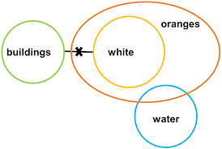
SYLLOGISM

Slide 2
SYLLOGISM
What is Syllogism?
The word syllogism is derived from the Greek word “syllogismos” which means “conclusion, inference”. Syllogisms are a logical argument of statements using deductive reasoning to arrive at a conclusion. The major contribution to the filed of syllogisms is attributed to Aristotle.
The questions which are asked in this section contain two or more statements, and two or more conclusions follow these statements. One has to find out which of these conclusions logically follow the given statements. The statements have to be taken true even if they seem to be at variance from the commonly known facts

Slide 3
SYLLOGISM
The questions of syllogisms of three main parts.
Major premise
Minor premise
Conclusion
The central premise is a statement in general, believed to be true by the author.
Example: All women are smart.
The minor premise is a specific example of the major premise.
Example: Nisha is a woman.
The conclusion is a specific statement which logically follows both major and minor statement.
Example: Nisha is smart.
Application of Venn diagrams

Slide 4
SYLLOGISM
Some more example:-
Major premise | Minor premise | Conclusion | Conclusion True/false
All dogs are cats. | All cats are bulls. | All bulls are dogs. | False(it’s true only according to 3rd case)
All dogs are cats. | All cats are bulls. | All dogs are bulls. | It’s true( In all the

Slide 5
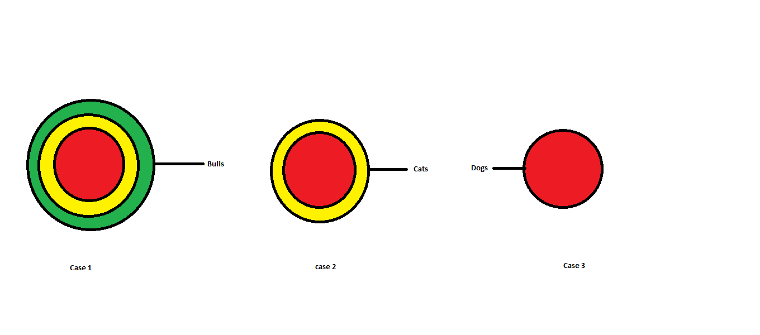
SYLLOGISM
Note:- The conclusion should be true according to all the possible cases. One should draw all possible cases before arriving at a conclusion. Below the table that provides that correct combination of Venn diagrams of major and minor premises

Slide 6
SYLLOGISM
Types of statements:
There are four types of statements in syllogism
1. All
2. Some
3. No
4. Some not
These statements can be represented will the help of Venn diagram

Slide 7
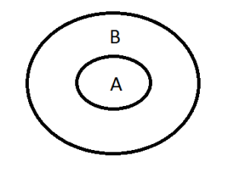
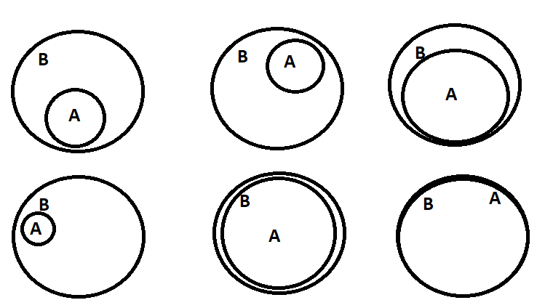
1.) All STATEMENT
All statement is written in the format “ALL A are B”, here A and B represent the subject and object of the statement.
Venn diagram

Slide 8
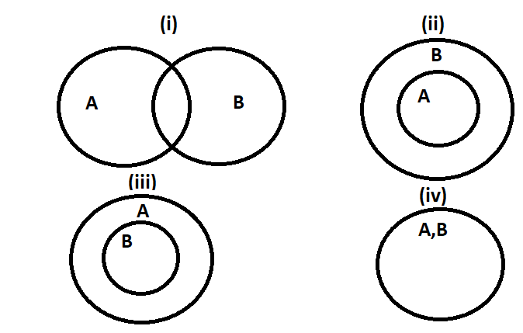
2.) SOME STATEMENT
Some statement is written in the format “Some A are B”, here A and B represent the subject and object of the statement.

Slide 9
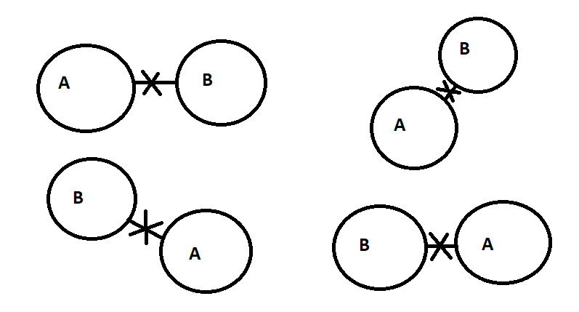
3.) NO STATEMENT
No statement is written in the format “No A are B”, here A and B represent the subject and object of the statement

Slide 10
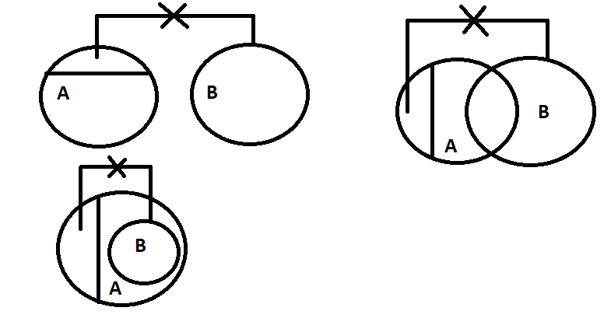
4.) SOME NOT STATEMENT
All statement is written in the format “Some A are not B”, here A and B represent the subject and object of the statement.

Slide 12
SYLLOGISM
Directions: In each of the questions below are given two statements followed by two conclusions numbered I and II. You have to take the given statements to be true even if they seem to at variance from commonly known facts. Read all the conclusions and then decide which of the given conclusions logically follows from the given statements disregarding commonly known facts. Give answer:
if only Conclusion I follows. (2) if only Conclusion II follows.
(3) if either Conclusion I or II follows. (4) if neither Conclusion I nor II follows.
(5) if both Conclusions I and II follow.
Q 1.
Statements: Some kites are threads.
No thread is needle.
Conclusions: I. Some kites are needles.
II. No needle is thread.

Slide 13
SYLLOGISM
Directions: In each of the questions below are given two statements followed by two conclusions numbered I and II. You have to take the given statements to be true even if they seem to at variance from commonly known facts. Read all the conclusions and then decide which of the given conclusions logically follows from the given statements disregarding commonly known facts. Give answer:
if only Conclusion I follows. (2) if only Conclusion II follows.
(3) if either Conclusion I or II follows. (4) if neither Conclusion I nor II follows.
(5) if both Conclusions I and II follow.
Q 1.
Statements: Some kites are threads.
No thread is needle.
Conclusions: I. Some kites are needles.
II. No needle is thread.

Slide 14
SYLLOGISM
Directions: In each of the questions below are given two statements followed by two conclusions numbered I and II. You have to take the given statements to be true even if they seem to at variance from commonly known facts. Read all the conclusions and then decide which of the given conclusions logically follows from the given statements disregarding commonly known facts. Give answer:
if only Conclusion I follows. (2) if only Conclusion II follows.
(3) if either Conclusion I or II follows. (4) if neither Conclusion I nor II follows.
(5) if both Conclusions I and II follow.
Q 2. Statements: Some trucks are houses.
Some houses are trains.
Conclusions: I. Some trains are trucks.
II. No train is truck.

Slide 15
SYLLOGISM
Directions: In each of the questions below are given two statements followed by two conclusions numbered I and II. You have to take the given statements to be true even if they seem to at variance from commonly known facts. Read all the conclusions and then decide which of the given conclusions logically follows from the given statements disregarding commonly known facts. Give answer:
if only Conclusion I follows. (2) if only Conclusion II follows.
(3) if either Conclusion I or II follows. (4) if neither Conclusion I nor II follows.
(5) if both Conclusions I and II follow.
Q 2. Statements: Some trucks are houses.
Some houses are trains.
Conclusions: I. Some trains are trucks.
II. No train is truck.

Slide 16
SYLLOGISM
Directions: In each of the questions below are given two statements followed by two conclusions numbered I and II. You have to take the given statements to be true even if they seem to at variance from commonly known facts. Read all the conclusions and then decide which of the given conclusions logically follows from the given statements disregarding commonly known facts. Give answer:
if only Conclusion I follows. (2) if only Conclusion II follows.
(3) if either Conclusion I or II follows. (4) if neither Conclusion I nor II follows.
(5) if both Conclusions I and II follow.
Q 3. Statements: All flowers are trees.
All trees are fruits.
Conclusions: I. Some fruits are flowers.
II. All flowers are fruits.

Slide 17
SYLLOGISM
Directions: In each of the questions below are given two statements followed by two conclusions numbered I and II. You have to take the given statements to be true even if they seem to at variance from commonly known facts. Read all the conclusions and then decide which of the given conclusions logically follows from the given statements disregarding commonly known facts. Give answer:
if only Conclusion I follows. (2) if only Conclusion II follows.
(3) if either Conclusion I or II follows. (4) if neither Conclusion I nor II follows.
(5) if both Conclusions I and II follow.
Q 3. Statements: All flowers are trees.
All trees are fruits.
Conclusions: I. Some fruits are flowers.
II. All flowers are fruits.

Slide 18
SYLLOGISM
Directions: In each of the questions below are given two statements followed by two conclusions numbered I and II. You have to take the given statements to be true even if they seem to at variance from commonly known facts. Read all the conclusions and then decide which of the given conclusions logically follows from the given statements disregarding commonly known facts. Give answer:
(1) if only Conclusion I follows. (2) if only Conclusion II follows.
(3) if either Conclusion I or II follows. (4) if neither Conclusion I nor II follows.
(5) if both Conclusions I and II follow.
Q 4. Statements: Some books are bags.
All bags are trees.
Conclusions: I. Some books are trees.
II. Some frees are books.

Slide 19
SYLLOGISM
Directions: In each of the questions below are given two statements followed by two conclusions numbered I and II. You have to take the given statements to be true even if they seem to at variance from commonly known facts. Read all the conclusions and then decide which of the given conclusions logically follows from the given statements disregarding commonly known facts. Give answer:
(1) if only Conclusion I follows. (2) if only Conclusion II follows.
(3) if either Conclusion I or II follows. (4) if neither Conclusion I nor II follows.
(5) if both Conclusions I and II follow.
Q 4. Statements: Some books are bags.
All bags are trees.
Conclusions: I. Some books are trees.
II. Some trees are books.

Slide 20
SYLLOGISM
Directions: In each of the questions below are given two statements followed by two conclusions numbered I and II. You have to take the given statements to be true even if they seem to at variance from commonly known facts. Read all the conclusions and then decide which of the given conclusions logically follows from the given statements disregarding commonly known facts. Give answer:
(1) if only Conclusion I follows. (2) if only Conclusion II follows.
(3) if either Conclusion I or II follows. (4) if neither Conclusion I nor II follows.
(5) if both Conclusions I and II follow.
Q 5. Statements: Some windows are doors.
No door is chair.
Conclusions: I. Some windows are chairs.
II. All doors are windows.

Slide 21
SYLLOGISM
Directions: In each of the questions below are given two statements followed by two conclusions numbered I and II. You have to take the given statements to be true even if they seem to at variance from commonly known facts. Read all the conclusions and then decide which of the given conclusions logically follows from the given statements disregarding commonly known facts. Give answer:
(1) if only Conclusion I follows. (2) if only Conclusion II follows.
(3) if either Conclusion I or II follows. (4) if neither Conclusion I nor II follows.
(5) if both Conclusions I and II follow.
Q 5. Statements: Some windows are doors.
No door is chair.
Conclusions: I. Some windows are chairs.
II. All doors are windows.

Slide 22
SYLLOGISM
Directions: In each of the questions below are given two statements followed by two conclusions numbered I and II. You have to take the given statements to be true even if they seem to at variance from commonly known facts. Read all the conclusions and then decide which of the given conclusions logically follows from the given statements disregarding commonly known facts. Give answer:
(1) if only Conclusion I follows. (2) if only Conclusion II follows.
(3) if either Conclusion I or II follows. (4) if neither Conclusion I nor II follows.
(5) if both Conclusions I and II follow.
Q 6. Statements: All forests are figures.
Some figures are houses.
Conclusions: I. Some houses are forests.
II. No house is forest.

Slide 23
SYLLOGISM
Directions: In each of the questions below are given two statements followed by two conclusions numbered I and II. You have to take the given statements to be true even if they seem to at variance from commonly known facts. Read all the conclusions and then decide which of the given conclusions logically follows from the given statements disregarding commonly known facts. Give answer:
(1) if only Conclusion I follows. (2) if only Conclusion II follows.
(3) if either Conclusion I or II follows. (4) if neither Conclusion I nor II follows.
(5) if both Conclusions I and II follow.
Q 6. Statements: All forests are figures.
Some figures are houses.
Conclusions: I. Some houses are forests.
II. No house is forest.

Slide 24
SYLLOGISM
Directions: In each of the questions below are given two statements followed by two conclusions numbered I and II. You have to take the given statements to be true even if they seem to at variance from commonly known facts. Read all the conclusions and then decide which of the given conclusions logically follows from the given statements disregarding commonly known facts. Give answer:
(1) if only Conclusion I follows. (2) if only Conclusion II follows.
(3) if either Conclusion I or II follows. (4) if neither Conclusion I nor II follows.
(5) if both Conclusions I and II follow.
Q 7. Statements: Some buses are trains.
Some trains are boats.
Conclusions: I. Some trains are buses.
II. Some boats are buses.

Slide 25
SYLLOGISM
Directions: In each of the questions below are given two statements followed by two conclusions numbered I and II. You have to take the given statements to be true even if they seem to at variance from commonly known facts. Read all the conclusions and then decide which of the given conclusions logically follows from the given statements disregarding commonly known facts. Give answer:
(1) if only Conclusion I follows. (2) if only Conclusion II follows.
(3) if either Conclusion I or II follows. (4) if neither Conclusion I nor II follows.
(5) if both Conclusions I and II follow.
Q 7. Statements: Some buses are trains.
Some trains are boats.
Conclusions: I. Some trains are buses.
II. Some boats are buses.

Slide 26
SYLLOGISM
Directions: In each of the questions below are given two statements followed by two conclusions numbered I and II. You have to take the given statements to be true even if they seem to at variance from commonly known facts. Read all the conclusions and then decide which of the given conclusions logically follows from the given statements disregarding commonly known facts. Give answer:
(1) if only Conclusion I follows. (2) if only Conclusion II follows.
(3) if either Conclusion I or II follows. (4) if neither Conclusion I nor II follows.
(5) if both Conclusions I and II follow.
Q 8. Statements: Some books are tables.
Some tables are mirrors.
Conclusions: I. Some mirrors are books.
II. No book is mirror.

Slide 27
SYLLOGISM
Directions: In each of the questions below are given two statements followed by two conclusions numbered I and II. You have to take the given statements to be true even if they seem to at variance from commonly known facts. Read all the conclusions and then decide which of the given conclusions logically follows from the given statements disregarding commonly known facts. Give answer:
(1) if only Conclusion I follows. (2) if only Conclusion II follows.
(3) if either Conclusion I or II follows. (4) if neither Conclusion I nor II follows.
(5) if both Conclusions I and II follow.
Q 8. Statements: Some books are tables.
Some tables are mirrors.
Conclusions: I. Some mirrors are books.
II. No book is mirror.

Slide 28
SYLLOGISM
Directions: In each of the questions below are given two statements followed by two conclusions numbered I and II. You have to take the given statements to be true even if they seem to at variance from commonly known facts. Read all the conclusions and then decide which of the given conclusions logically follows from the given statements disregarding commonly known facts. Give answer:
(1) if only Conclusion I follows. (2) if only Conclusion II follows.
(3) if either Conclusion I or II follows. (4) if neither Conclusion I nor II follows.
(5) if both Conclusions I and II follow.
Q 9. Statements: All flowers are trees.
No fruit is tree.
Conclusions: I. No fruit is flower.
II. Some trees are flowers.

Slide 29
SYLLOGISM
Directions: In each of the questions below are given two statements followed by two conclusions numbered I and II. You have to take the given statements to be true even if they seem to at variance from commonly known facts. Read all the conclusions and then decide which of the given conclusions logically follows from the given statements disregarding commonly known facts. Give answer:
(1) if only Conclusion I follows. (2) if only Conclusion II follows.
(3) if either Conclusion I or II follows. (4) if neither Conclusion I nor II follows.
(5) if both Conclusions I and II follow.
Q 9. Statements: All flowers are trees.
No fruit is tree.
Conclusions: I. No fruit is flower.
II. Some trees are flowers.

Slide 30
SYLLOGISM
Directions: In each of the questions below are given two statements followed by two conclusions numbered I and II. You have to take the given statements to be true even if they seem to at variance from commonly known facts. Read all the conclusions and then decide which of the given conclusions logically follows from the given statements disregarding commonly known facts. Give answer:
(1) if only Conclusion I follows. (2) if only Conclusion II follows.
(3) if either Conclusion I or II follows. (4) if neither Conclusion I nor II follows.
(5) if both Conclusions I and II follow.
Q 10. Statements: All pens are chalks.
All chairs are chalks.
Conclusions: I. Some pens are chairs.
II. Some chalks are pens.

Slide 31
SYLLOGISM
Directions: In each of the questions below are given two statements followed by two conclusions numbered I and II. You have to take the given statements to be true even if they seem to at variance from commonly known facts. Read all the conclusions and then decide which of the given conclusions logically follows from the given statements disregarding commonly known facts. Give answer:
(1) if only Conclusion I follows. (2) if only Conclusion II follows.
(3) if either Conclusion I or II follows. (4) if neither Conclusion I nor II follows.
(5) if both Conclusions I and II follow.
Q 10. Statements: All pens are chalks.
All chairs are chalks.
Conclusions: I. Some pens are chairs.
II. Some chalks are pens.

Slide 32
SYLLOGISM
Directions: In each of the questions below are given two statements followed by two conclusions numbered I and II. You have to take the given statements to be true even if they seem to at variance from commonly known facts. Read all the conclusions and then decide which of the given conclusions logically follows from the given statements disregarding commonly known facts. Give answer:
(1) if only Conclusion I follows. (2) if only Conclusion II follows.
(3) if either Conclusion I or II follows. (4) if neither Conclusion I nor II follows.
(5) if both Conclusions I and II follow.
Q 11. Statements: Some buses are bells.
Some bells are horses.
All trains are horses.
Conclusions: I. Some buses are horses.
II. Some trains are bells.

Slide 33
SYLLOGISM
Directions: In each of the questions below are given two statements followed by two conclusions numbered I and II. You have to take the given statements to be true even if they seem to at variance from commonly known facts. Read all the conclusions and then decide which of the given conclusions logically follows from the given statements disregarding commonly known facts. Give answer:
(1) if only Conclusion I follows. (2) if only Conclusion II follows.
(3) if either Conclusion I or II follows. (4) if neither Conclusion I nor II follows.
(5) if both Conclusions I and II follow.
Q 11. Statements: Some buses are bells.
Some bells are horses.
All trains are horses.
Conclusions: I. Some buses are horses.
II. Some trains are bells.

Slide 34
SYLLOGISM
Directions: In each of the questions below are given two statements followed by two conclusions numbered I and II. You have to take the given statements to be true even if they seem to at variance from commonly known facts. Read all the conclusions and then decide which of the given conclusions logically follows from the given statements disregarding commonly known facts. Give answer:
(1) if only Conclusion I follows. (2) if only Conclusion II follows.
(3) if either Conclusion I or II follows. (4) if neither Conclusion I nor II follows.
(5) if both Conclusions I and II follow.
Q 12. Statements: All classes are lions.
Some birds are classes.
All pens are lions.
Conclusions: I. No pen is bird.
II. Some birds are pens.

Slide 35
SYLLOGISM
Directions: In each of the questions below are given two statements followed by two conclusions numbered I and II. You have to take the given statements to be true even if they seem to at variance from commonly known facts. Read all the conclusions and then decide which of the given conclusions logically follows from the given statements disregarding commonly known facts. Give answer:
(1) if only Conclusion I follows. (2) if only Conclusion II follows.
(3) if either Conclusion I or II follows. (4) if neither Conclusion I nor II follows.
(5) if both Conclusions I and II follow.
Q 12. Statements: All classes are lions.
Some birds are classes.
All pens are lions.
Conclusions: I. No pen is bird.
II. Some birds are pens.

Slide 36
SYLLOGISM
Q 13. Statements: All petals are trees.
All trees are gardens.
All roads are gardens.
Conclusions: I. Some roads are trees.
II. Some gardens are trees.
III. Some gardens are petals.
Only I and II follow
(2) Only II and III follow
(3) Only I and III follow
(4) All I, II and III follow
(5) None of these

Slide 37
SYLLOGISM
Q 13. Statements: All petals are trees.
All trees are gardens.
All roads are gardens.
Conclusions: I. Some roads are trees.
II. Some gardens are trees.
III. Some gardens are petals.
Only I and II follow
(2) Only II and III follow
(3) Only I and III follow
(4) All I, II and III follow
(5) None of these

Slide 38
SYLLOGISM
Q 14. Statements: All keys are locks.
No lock is toy.
All bags are toys.
Conclusions: I. No bag is key.
II. Some bags are keys.
III. Some toys are keys.
None follows
(2) Only I follows
(3) Only II follows
(4) Only III follows
(5) Only I and II follow

Slide 39
SYLLOGISM
Q 14. Statements: All keys are locks.
No lock is toy.
All bags are toys.
Conclusions: I. No bag is key.
II. Some bags are keys.
III. Some toys are keys.
None follows
(2) Only I follows
(3) Only II follows
(4) Only III follows
(5) Only I and II follow

Slide 40
SYLLOGISM
Q 15. Statements: Some days are nights.
Some nights are months.
Some months are years.
Conclusions: I. Some years are nights.
II. Some months are days.
III. No year is night.
Only I follows
(2) Only II follows
(3) Only III follows
(4) Only either I or III follows
(5) None of these

Slide 41
SYLLOGISM
Q 15. Statements: Some days are nights.
Some nights are months.
Some months are years.
Conclusions: I. Some years are nights.
II. Some months are days.
III. No years is night.
Only I follows
(2) Only II follows
(3) Only III follows
(4) Only either I or III follows
(5) None of these

Slide 42
SYLLOGISM
Q 16. Statements: All cycles are tyres.
Some tyres are wheels.
All wheels are buses.
Conclusions: I. Some buses are tyres.
II. Some wheels are tyres.
III. Some buses are cycles.
Only I and II follow
(2) Only I and III follow
(3) Only II and III follow
(4) All I, II and III follow
(5) None of these

Slide 43
SYLLOGISM
Q 16. Statements: All cycles are tyres.
Some tyres are wheels.
All wheels are buses.
Conclusions: I. Some buses are tyres.
II. Some wheels are tyres.
III. Some buses are cycles.
Only I and II follow
(2) Only I and III follow
(3) Only II and III follow
(4) All I, II and III follow
(5) None of these

Slide 44
SYLLOGISM
Q 17. Statements: Some dogs are cats.
Some cats are horses.
All horses are tigers.
Conclusions :I. Some tigers are cats.
II. Some horses are dogs.
III. Some tigers are dogs.
None follows
(2) Only I follows
(3) Only II follows
(4) Only III follows
(5) Only II and III follow

Slide 45
SYLLOGISM
Q 17. Statements: Some dogs are cats.
Some cats are horses.
All horses are tigers.
Conclusions :I. Some tigers are cats.
II. Some horses are dogs.
III. Some tigers are dogs.
None follows
(2) Only I follows
(3) Only II follows
(4) Only III follows
(5) Only II and III follow

Slide 46
SYLLOGISM
Q 18. Statements: Some leaves are baskets.
Some baskets are flowers.
Some flowers are lakes.
Conclusions: I. Some lakes are baskets.
II. Some flowers are lakes.
III. No lake is basket.
Only I follows
(2) Only II follows
(3) Only III follows
(4) Only either I or III follows
(5) None of these

Slide 47
SYLLOGISM
Q 18. Statements: Some leaves are baskets.
Some baskets are flowers.
Some flowers are lakes.
Conclusions: I. Some lakes are baskets.
II. Some flowers are lakes.
III. No lake is basket.
Only I follows
(2) Only II follows
(3) Only III follows
(4) Only either I or III follows
(5) None of these

Slide 48
SYLLOGISM
Q 19. Statements: All pictures are bands.
Some bands are chairs.
Some chairs are tables.
Conclusions: I. Some tables are bands.
II. Some chairs are pictures.
III. Some tables are pictures.
None follows
(2) Only I follows
(3) Only II follows
(4) Only I and II follow
(5) Only III follows

Slide 49
SYLLOGISM
Q 19. Statements: All pictures are bands.
Some bands are chairs.
Some chairs are tables.
Conclusions: I. Some tables are bands.
II. Some chairs are pictures.
III. Some tables are pictures.
None follows
(2) Only I follows
(3) Only II follows
(4) Only I and II follow
(5) Only III follows

Slide 50
SYLLOGISM
Q 20. Statements : Some bikes are cars.
Some cars are trains.
Some trains are buses.
Conclusions : I. Some buses are cars.
II. Some trains are bikes.
III. Some buses are bikes.
None follows
(2) Only I follows
(3) Only II follows
(4) Only III follows
(5) Only I and II follow

Slide 51
SYLLOGISM
Q 20. Statements : Some bikes are cars.
Some cars are trains.
Some trains are buses.
Conclusions : I. Some buses are cars.
II. Some trains are bikes.
III. Some buses are bikes.
None follows
(2) Only I follows
(3) Only II follows
(4) Only III follows
(5) Only I and II follow

Slide 52
SYLLOGISM
Q 21. Statements : All dogs are cats.
Some cats are rats.
All rats are mats.
Conclusions: I. Some mats are cats.
II. Some mats are dogs.
III. Some rats are cats.
Only I follows
(2) Only II follows
(3) Only III follows
(4) Only I and III follow
(5) None of these

Slide 53
SYLLOGISM
Q 21. Statements : All dogs are cats.
Some cats are rats.
All rats are mats.
Conclusions: I. Some mats are cats.
II. Some mats are dogs.
III. Some rats are cats.
Only I follows
(2) Only II follows
(3) Only III follows
(4) Only I and III follow
(5) None of these

Slide 54
SYLLOGISM
Q 22. Statements: Some boxes are walls.
No wall is road.
All roads are rivers.
Conclusions: I. Some rivers are walls
II. Some roads are boxes
III. No wall is river
Only I follows
(2) Only either I or III follows
(3) Only III follows
(4) Only II follows
(5) Only II and III follow

Slide 55
SYLLOGISM
Q 22. Statements: Some boxes are walls.
No wall is road.
All roads are rivers.
Conclusions: I. Some rivers are walls
II. Some roads are boxes
III. No wall is river
Only I follows
(2) Only either I or III follows
(3) Only III follows
(4) Only II follows
(5) Only II and III follow

Slide 56
SYLLOGISM
Q 23. Statements : Some tables are chairs.
All chairs are houses.
All houses are tents.
Conclusions: I. All houses are chairs.
II. Some tents are chairs.
III. Some houses are tables.
Only I and II follow
(2) Only I and III follow
(3) Only II and III follow
(4) All I, II and III follow
(5) None of these

Slide 57
SYLLOGISM
Q 23. Statements : Some tables are chairs.
All chairs are houses.
All houses are tents.
Conclusions: I. All houses are chairs.
II. Some tents are chairs.
III. Some houses are tables.
Only I and II follow
(2) Only I and III follow
(3) Only II and III follow
(4) All I, II and III follow
(5) None of these

Slide 58
SYLLOGISM
Q 24. Statements : All pens are sticks.
All sticks are rings.
All rings are rods.
Conclusions : I. Some rings are pens.
II. Some rods are sticks.
III. Some rods are pens.
Only I and II follow
(2) Only I and III follow
(3) Only II and III follow
(4) All I, II and III follow
(5) None of these

Slide 59
SYLLOGISM
Q 24. Statements : All pens are sticks.
All sticks are rings.
All rings are rods.
Conclusions : I. Some rings are pens.
II. Some rods are sticks.
III. Some rods are pens.
Only I and II follow
(2) Only I and III follow
(3) Only II and III follow
(4) All I, II and III follow
(5) None of these

Slide 60
SYLLOGISM
Q 25. Statements: Some nails are plates.
Some plates are disks.
All disks are mirrors.
All mirrors are tyres.
Conclusions: I. Some tyres are plates.
II. Some tyres are nails.
III. Some mirrors are plates.
Only I and II follow
(2) Only I and III follow
(3) Only II and III follow
(4) All I, II and III follow
(5) None of these

Slide 61
SYLLOGISM
Q 25. Statements: Some nails are plates.
Some plates are disks.
All disks are mirrors.
All mirrors are tyres.
Conclusions: I. Some tyres are plates.
II. Some tyres are nails.
III. Some mirrors are plates.
Only I and II follow
(2) Only I and III follow
(3) Only II and III follow
(4) All I, II and III follow
(5) None of these

Slide 62
SYLLOGISM
Q 26. Statements: Some beads are chairs.
All chairs are trucks.
Some trucks are bricks.
All bricks are cars.
Conclusions: I. Some cars are chairs.
II. Some cars are trucks.
III. Some trucks are beads.
Only I and II follow
(2) Only I and III follow
(3) Only II and III follow
(4) All I, II and III follow
(5) None of these

Slide 63
SYLLOGISM
Q 26. Statements: Some beads are chairs.
All chairs are trucks.
Some trucks are bricks.
All bricks are cars.
Conclusions: I. Some cars are chairs.
II. Some cars are trucks.
III. Some trucks are beads.
Only I and II follow
(2) Only I and III follow
(3) Only II and III follow
(4) All I, II and III follow
(5) None of these

Slide 64
SYLLOGISM
Q 27. Statements: All shirts are hats.
No hat is suit. Some rings are suits.
All rings are bangles.
Conclusions: I. Some rings are hats.
II. Some bangles are suits.
III. No ring is hat.
Only I follows
(2) Only II follows
(3) Only III follows
(4) Only either I or III follows
(5) Only either I or III and II follow

Slide 65
SYLLOGISM
Q 27. Statements: All shirts are hats.
No hat is suit. Some rings are suits.
All rings are bangles.
Conclusions: I. Some rings are hats.
II. Some bangles are suits.
III. No ring is hat.
Only I follows
(2) Only II follows
(3) Only III follows
(4) Only either I or III follows
(5) Only either I or III and II follow

Slide 66
SYLLOGISM
Q 28. Statements: Some skies are rains.
Some rains are stars.
All stars are planets.
All planets are clouds.
Conclusions: I. Some clouds are rains.
II. Some planets are skies.
III. Some planets are rains.
Only I and II follow
(2) Only I and III follow
(3) Only II and III follow
(4) All I, II and III follow
(5) None of these

Slide 67
SYLLOGISM
Q 28. Statements: Some skies are rains.
Some rains are stars.
All stars are planets.
All planets are clouds.
Conclusions: I. Some clouds are rains.
II. Some planets are skies.
III. Some planets are rains.
Only I and II follow
(2) Only I and III follow
(3) Only II and III follow
(4) All I, II and III follow
(5) None of these

Slide 68
SYLLOGISM
Q 29. Statements: All birds are goats.
No goat is flower.
Some flowers are mountains.
Some mountains are nets.
Conclusions: I. Some nets are goats.
II. No net is goat.
III. Some mountains are birds.
None follows
(2) Only I follows
(3) Only either I or II follows
(4) Only II follows
(5) Only III follows

Slide 69
SYLLOGISM
Q 29. Statements: All birds are goats.
No goat is flower.
Some flowers are mountains.
Some mountains are nets.
Conclusions: I. Some nets are goats.
II. No net is goat.
III. Some mountains are birds.
None follows
(2) Only I follows
(3) Only either I or II follows
(4) Only II follows
(5) Only III follows

Slide 70
SYLLOGISM
Q 30. Statements: Some leaves are skies.
All skies are clouds.
No cloud is a boat.
Conclusions: I. Some boats are leaves.
II. Some clouds are leaves.
III. All skies are leaves.
IV. No leaf is a boat.
Only I, II and IV follow
(2) Only II, III and IV follow
(3) Either I or IV and II follow
(4) Either I or IV and III follow
(5) None of these

Slide 71
SYLLOGISM
Q 30. Statements: Some leaves are skies.
All skies are clouds.
No cloud is a boat.
Conclusions: I. Some boats are leaves.
II. Some clouds are leaves.
III. All skies are leaves.
IV. No leaf is a boat.
Only I, II and IV follow
(2) Only II, III and IV follow
(3) Either I or IV and II follow
(4) Either I or IV and III follow
(5) None of these

Slide 72
SYLLOGISM
Q 31. Statements: No building is white.
All whites are oranges.
Some oranges are waters.
Conclusions: I. No building is water.
II. No orange is a building.
III. Some oranges are whites.
IV. Some waters are building.
Either I or IV and II follow
(2) Either I or IV and III follow
(3) Either I or IV follows
(4) None follows
(5) Either I or IV and II and III follow

Slide 73
SYLLOGISM
Q 31. Statements: No building is white.
All whites are oranges.
Some oranges are waters.
Conclusions: I. No building is water.
II. No orange is a building.
III. Some oranges are whites.
IV. Some waters are building.
Either I or IV and II follow
(2) Either I or IV and III follow
(3) Either I or IV follows
(4) None follows
(5) Either I or IV and II and III follow

Slide 74
SYLLOGISM
Q 32. Statements: Some mangoes are apples.
Some bananas are apples.
Some branches are bananas.
Conclusions: I. Some mangoes are bananas.
II. Some branches are apples.
III. Some branches are mangoes.
IV. All apples are mangoes.
None follows
(2) Only I and II follow
(3) Only III and IV follow
(4) Only I and IV follow
(5) All follow

Slide 75
SYLLOGISM
Q 32. Statements: Some mangoes are apples.
Some bananas are apples.
Some branches are bananas.
Conclusions: I. Some mangoes are bananas.
II. Some branches are apples.
III. Some branches are mangoes.
IV. All apples are mangoes.
None follows
(2) Only I and II follow
(3) Only III and IV follow
(4) Only I and IV follow
(5) All follow

Slide 76
THANK YOU

